Slide 1
What are these bones of the upper extremity?
Clavicle
Scapula
Humerus
Ulna
Radius
Carpals
Metacarpals
Phalanges

Slide 2
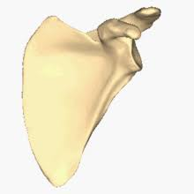
What are the 3 landmarks of the scapula?
2. Acromion process
3. Glenoid fossa
1.
Spine of Scapula

Slide 3
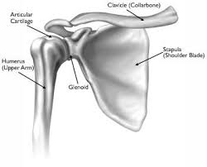
What are the two joints of the shoulder?
Acromioclavicular
Glenohumeral

Slide 4
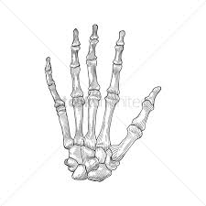
What are the 3 joints of the phalanges?
Metacarpal Phalangeal (MCP)
Proximal Interphalangeal (PIP)
Distal Interphalangeal (DIP)

Slide 5
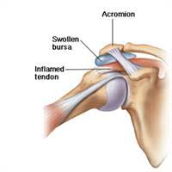
What is the subacromial Bursa?
A fluid filled sack just below the acromion process

Slide 6
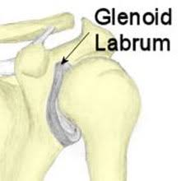
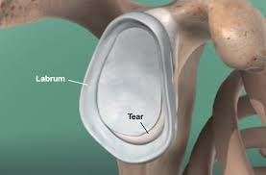
What is the purpose of the Glenoid Labrum?
It helps deepen the socket of the shoulder

Slide 7
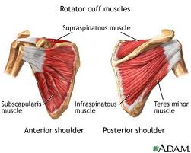
What are the 4 rotator cuff muscles?
Supraspinatus
Infraspinatus
Teres minor
Subscapularis

Slide 8
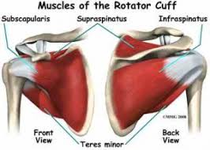
What movement do each of the rotator cuff perform?
Supraspinatus
External Rotation
Infraspinatus
External Rotation
Teres Minor
External Rotation
Subscapularis
Internal Rotation

Slide 9
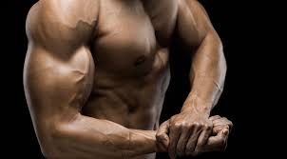
Where is the bicep brachii located and what is its primary movement?
Anterior aspect of the upper arm
Flexes the elbow

Slide 10
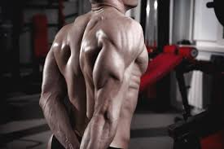
What is the movement of the triceps brachii
Extends the elbow

Slide 11
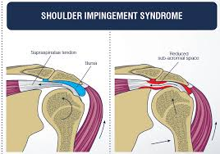
What injury do you get when you do a lot of over head exercises?
Shoulder impingement syndrome

Slide 12
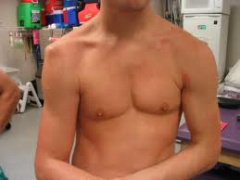
The injury sign is a flattened deltoid and is caused by forced abduction and external rotation
Shoulder dislocation

Slide 13
Landing on the tip of your shoulder can separate this joint and ligament?
AC joint and ligament

Slide 14
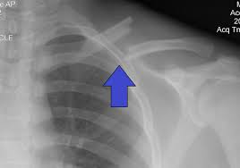
What injury results in a direct impact to the clavicle?
Clavicle Fracture

Slide 15
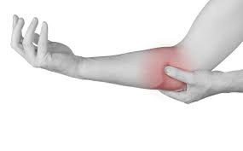
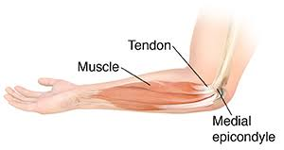
What is the cause of medial epicondylitis?
Repetitive flexion of the wrist

Slide 16
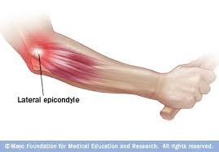
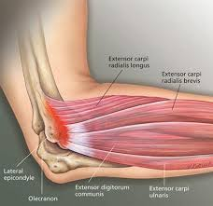
What causes lateral epicondylitis?
Repetitive Extension

Slide 17
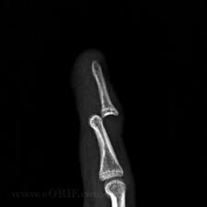
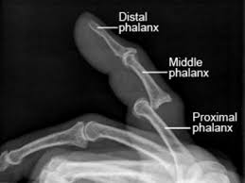
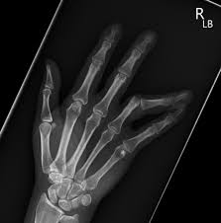
A blow to the tip of the finger could cause
Interphalangeal Dislocation

