Slide 1
Unit 9 Review
Strength Training, Flexibility and Ergogenic Aides

Slide 2
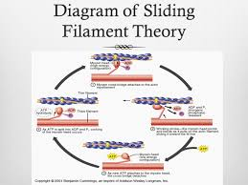
What causes Muscle Contraction?
Sliding filament theory
Proteins called actin and myosin slide past one another to generate movement

Slide 3
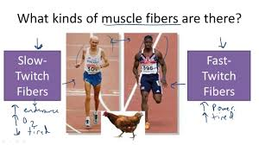
What does a slow twitch muscle fiber need to continue to fire?
Oxygen

Slide 4
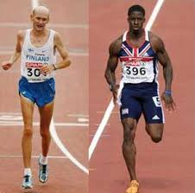
Fast twitch Muscle Fiber Generate what?
Short bursts of strength and speed
They fatigue quickly

Slide 5
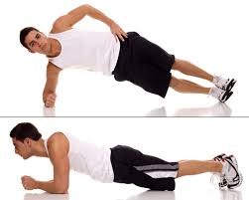
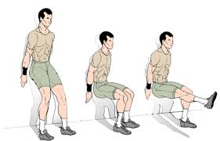
What type of strength training uses no movement?
Isometric

Slide 6
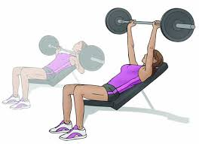
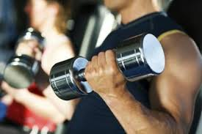
What type of movement is ISOTONIC
Fixed weight, variable speed
Joint is moved through full ROM

Slide 7
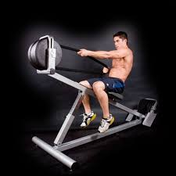
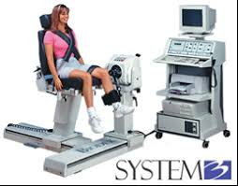
Which type of strength movement requires a machine?
Isokinetic

Slide 8
What is isokinetic definition?
Fixed Speed, Variable resistance

Slide 9
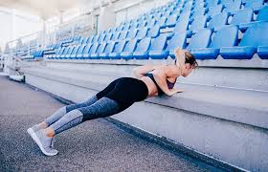
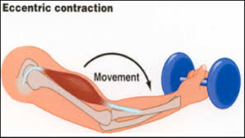
Describe an eccentric movement
Negative work
Muscle lengthened while weight is lowered
Produce great strength gains, but more muscle soreness
Ex: down movement of bicep curl

Slide 10
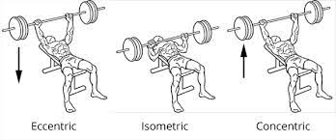
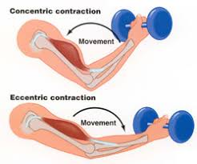
Describe Concentric movement
Positive work
Muscle shortens as weight is lifted
Ex: up movement of bicep curl

Slide 11
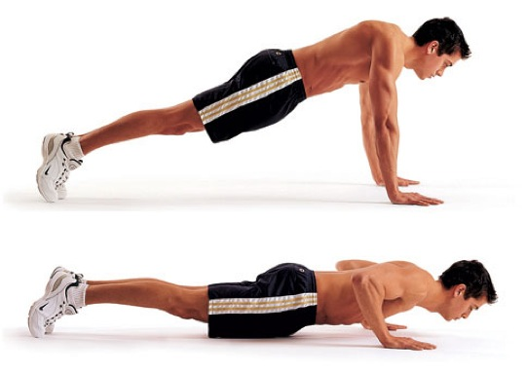
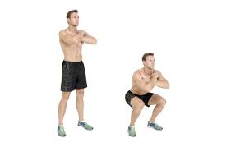
Describe what closed chain exercises are and what is an example?
Distal segment is fixed
Body squats, lunges, pushups

Slide 12
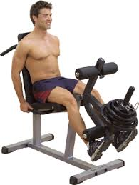
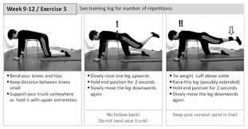
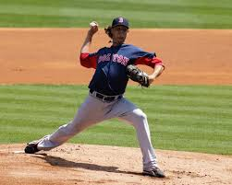
What is the definition of Open Chained exercise
Distal segments are not fixed and freely moving in space

Slide 13
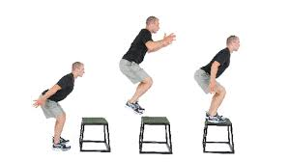
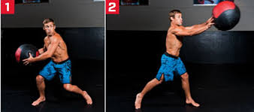
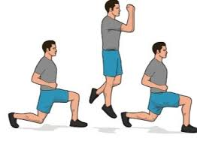
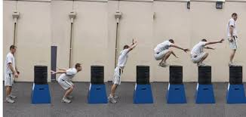
What are some examples of Plyometrics
Jumps
Bounds
Skips
Hops
Medicine ball throws

Slide 14
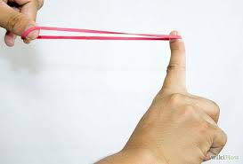
What is the stretch reflex?
stretch the muscle from its resting length immediately before the concentric contraction
The greater the stretch, the greater the load (power generated) the muscle can lift.

Slide 15
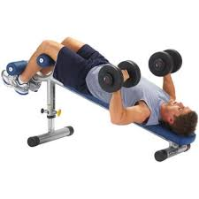
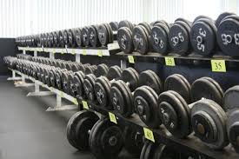
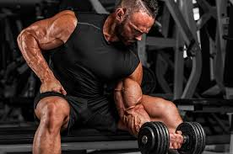
Describe Free weights
Weights that are not fixed to any object and can be picked up and moved anywhere
Variety of exercises can be done

Slide 16
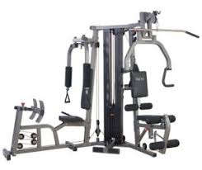
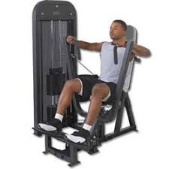
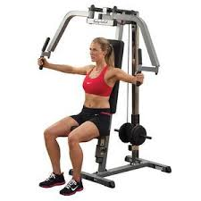
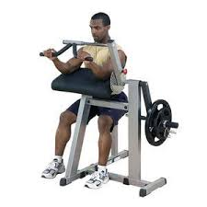
Why are weight machines relatively safe?
The machine will stop the weight from falling on the individual

Slide 17
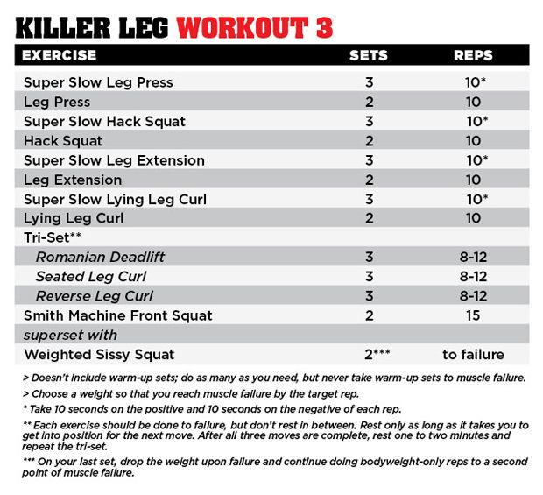
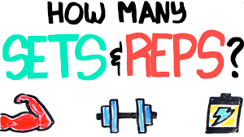
How does repetitions and sets go together?
A set is how many rounds of an exercise someone will do
Repetitions are how many times you will do that exercise in 1 round
Example 3x15

Slide 18
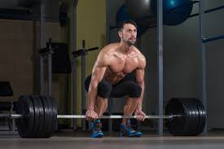
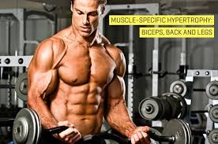
If you want to build muscle mass what should your plans be when it comes to how much weight to lift?
High resistance and low repetitions

Slide 19
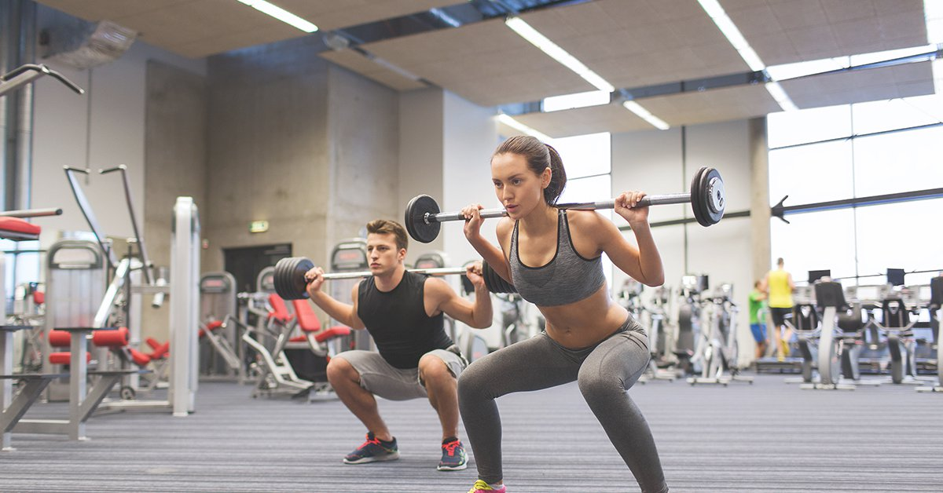
If you want to build endurance what should your equation be?
Low resistance and high repetitions

Slide 20
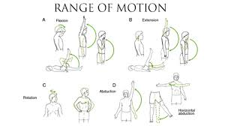
What is ROM
Range of motion
The range that a joint can be moved

Slide 21
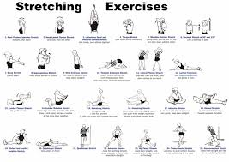
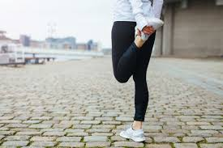
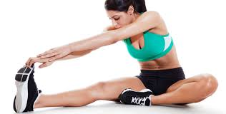
When should you do static stretching?
After activity

Slide 22
How should static stretching be done?
Stretching to a comfortable position and holding for a period of time.
No motion should be forced
Hold stretch for 10-30 seconds (longer time, less intensity)
Should be used at the end of a training session

Slide 23
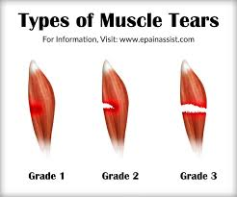
Why is ballistic stretching bad?
there is the potential to cause musculoskeletal injuries due to the bouncing

Slide 24
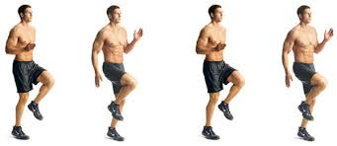
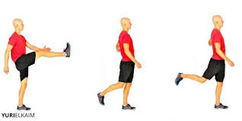
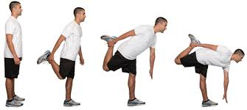
How is dynamic stretching done? And when is it recommended to use this type of stretching?
Active muscular effort are used to propel the muscle into an extended range of motion
Functional based exercises, use sport specific movements to prepare the body for training
Beneficial way to warm up prior to training

Slide 25
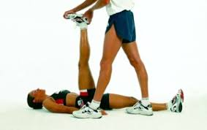
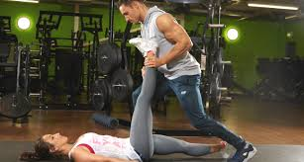
What are the two types of proprioceptive neuromuscular facilitation?
Contract/ Relax
Hold/ Relax

Slide 26
How is contract/ Relax done?
Stretch until resistance is felt
Contract the muscles against a partner
Move through a range of motion
Moved to a new stretch position beyond the original stretch

Slide 27
How is Hold/ Relax done?
Athlete stretches to a comfortable position
Apply force against a partner
Holds the contraction for 10-15 seconds
Move to a new stretch position beyond the original starting point

Slide 28
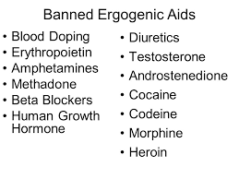
What are ergogenic aids?
Any substance (or food) that is believed to enhance one’s performance above normal standards.

Slide 29
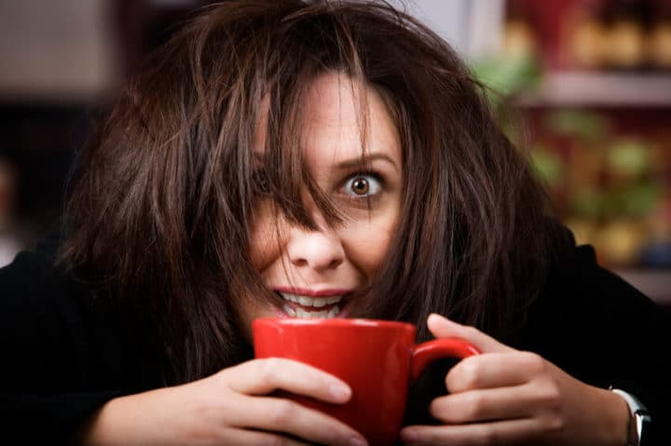
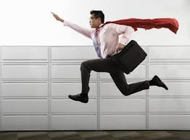
What does ephedra and Caffeine do to the body?
Increase alertness, reduce tiredness and increase their competitiveness and aggressiveness

Slide 30
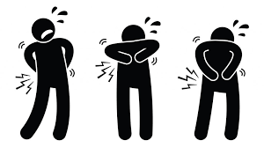
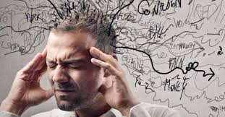
Why would someone abuse narcotics?
May reduce anxiety, and decrease pain

Slide 31
What is anabolic steroids?
synthetic variations of the male sex hormone testosterone.

Slide 32
Why do beta blockers work?
They reduce your blood pressure and blocks epinephrine and the adrenaline
Heart beats slower

Slide 33
Why would someone want to blood dope?
So that they have extra RBC’s at the time of their event

