Slide 1
Unit 1 Review
Careers and Ethics

Slide 2
Sports Medicine Team

Slide 3
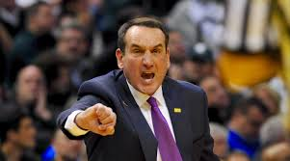
Role of the Coach
Ensure athletes are properly conditioned.
Trains athletes in correct skill technique.
Ensures protective equipment is maintained and fitted properly.
Provide proper first aid in the absence of an athletic trainer.
Should be CPR/AED certified
Refer athletes to appropriate medical providers.

Slide 4
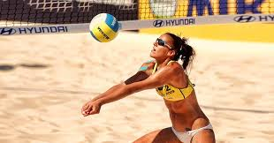
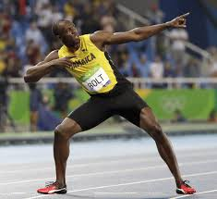
Roles of the Athlete
Train and condition to prevent injury.
Be well informed of their injury if hurt.
Listen to their body to prevent re-injury.

Slide 5
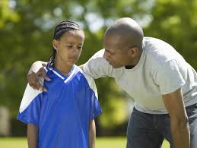
Roles of the Parent
Important when dealing with athletes in youth sports and/or secondary schools
Communication vital regarding the care and injury status of their athlete.

Slide 6
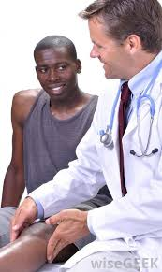
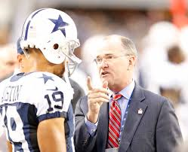
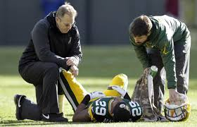
Roles of the Team Physician
Coordinates care with the athletic trainer.
Makes decisions relative to care and return to play for the athlete.

Slide 7
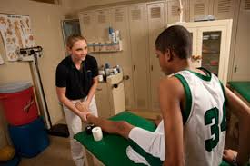
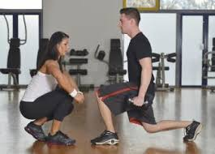
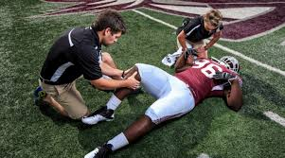
Role of the Athletic Trainer
Involved in all aspects of care.
Injury Prevention
Initial First Aid & Injury Management
Injury Evaluation
Rehabilitation
Facilitates safe return to play.

Slide 8
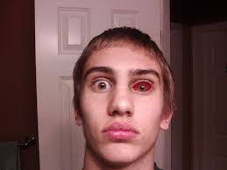
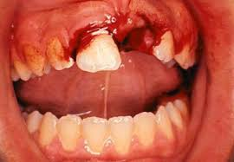
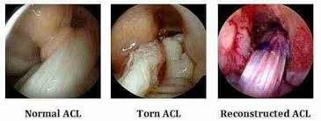
Why is the other allied health providers a member of the sports medicine team?
Sometimes the nature of the injury requires involving other providers.

Slide 9
Careers- What is the job description?

Slide 10
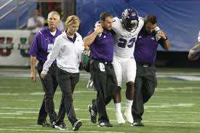
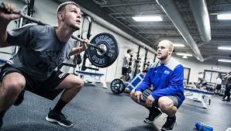
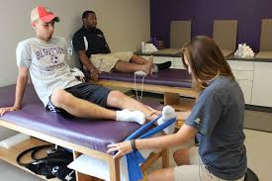
Athletic Trainer
Prevent, evaluation, care, and rehabilitate injuries.

Slide 11
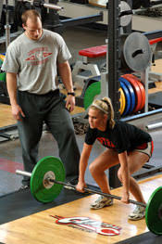
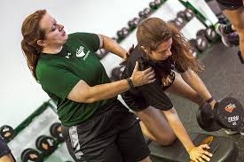
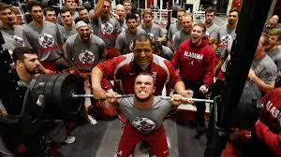
Certified Strength and Conditioning Coach
Lead, instruct, and motivate individuals or groups in exercise activities

Slide 12
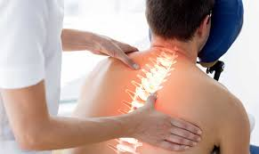
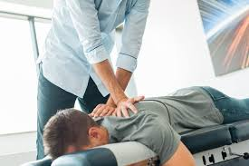
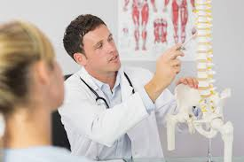
Chiropractor
Diagnose and treat patients with health problems of the spine.

Slide 13
Registered Dietician
Prevent and treat illnesses by promoting healthy eating habits and recommending dietary modifications

Slide 14
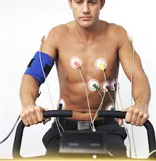
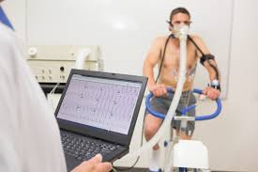
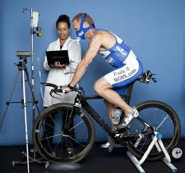
Exercise Physiologist
Expert in the effect of exercise on the human body

Slide 15
Family Physician
Diagnose illness, prescribe, and administer treatment for people with injury or disease

Slide 16
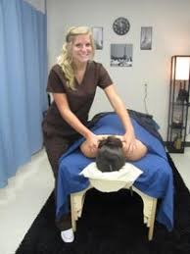
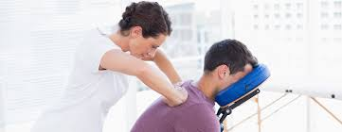
Licensed Massage Therapist
Using touch to manipulate the soft-tissue muscles of the body to restore function

Slide 17
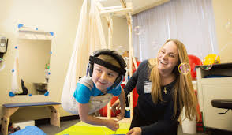
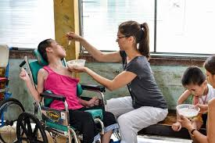
Occupational Therapist
Help with conditions that are mentally, physically, developmentally, or emotionally disabling for daily living/career.

Slide 18
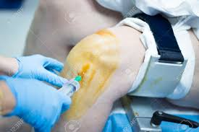
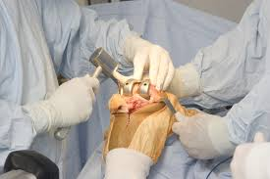
Orthopedic Surgeon
Use surgical methods to investigate, preserve and restore functions to a patient's extremities or spine

Slide 19
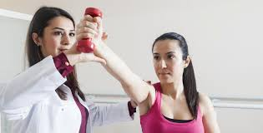
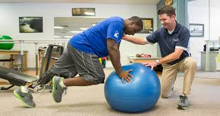
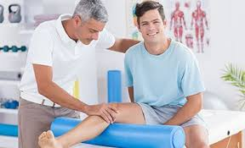
Physical Therapist
Restore, maintain, and promote overall fitness and health, relieve pain, improve mobility.

Slide 20
Physician Assistant
Practice medicine under the supervision of physicians and surgeons.

Slide 21
Nurse Practitioner
Diagnose and follow the patient through treatment.

Slide 22
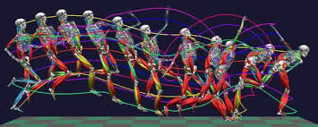
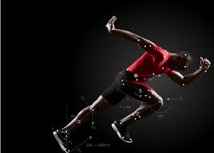
Biomechanist
Private sector working with athletes and coaches.
Education

Slide 23
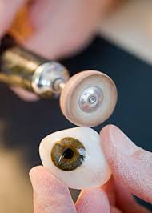
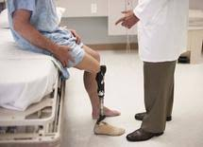
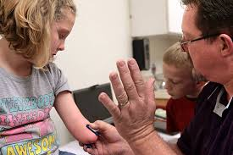
Orthotist and Prosthetist
Research and apply prosthesis.
Help patient find the right fit/function

Slide 24
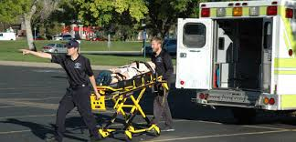
Emergency Medical Technician
Know and apply basic and some advanced life saving skills to traumatic injuries.

Slide 25
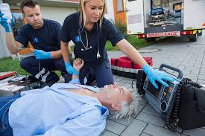
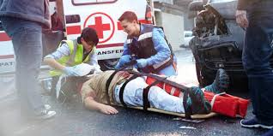
Paramedic
First on scene, initial assessments, 48 hour shifts,

Slide 26
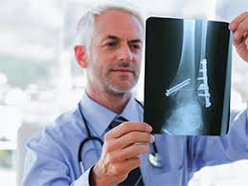
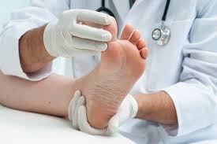
Podiatrist
Diagnose and treat disorders, diseases, and injuries of the foot and lower leg.

Slide 27
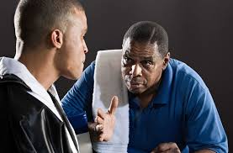
Sports Psychologist
Study mental processes/ behavior by observing, interpreting, and recording how people relate to one another and the environment.

Slide 28
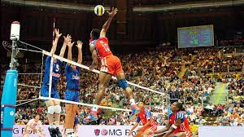
What sports are non-contact
Archery
Badminton
Bowling
Crew/rowing
Cross country running
Curling
Fencing
Golf
Gymnastics
Skiing/Snowboarding
Squash
Swimming
Diving
Tennis
Track & Field
Volleyball

Slide 29
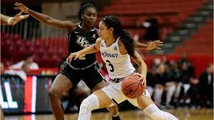
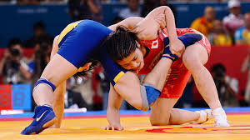
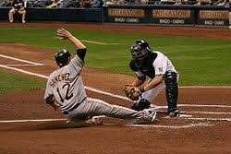
What sports are contact sports
Basketball
Baseball
Field Hockey
Lacrosse
Rodeo
Soccer
Softball
Water Polo
Wrestling

Slide 30
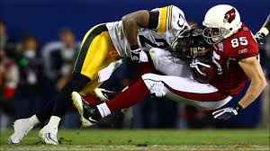
What sports are Collision Sports
Football
Hockey
Rugby

Slide 31
Which sport has the most catastrophic injuries?
Collision

Slide 32
Assumption of Risk
It is assumed that an individual who participates in an activity and is injured as a result of the ordinary risk associated at the activity will not have grounds for negligence.

Slide 33
Battery
Touching someone without their permission

Slide 34
Commission
Doing something a reasonable person would not do under similar circumstances

Slide 35
Omission
Not doing something that a reasonable preson would do under similar circumstances

Slide 36
Failure to warn
Failing to inform a participant of potential risks and dangers. When dealing with minors, failing to warn parents or obtaining consent.

Slide 37
What is HIPAA
Privacy of health information

Slide 38
Informed Consent
Being informed of all procedures and the potential risks and benefits of each.

Slide 39
Liability
The legal responsibility to act in a reasonable manner

Slide 40
Malpractice
Bad Practice or committing a negligent act

Slide 41
Negligence
Failure to use ordinary or reasonable care

Slide 42
4 things of Negligence
Duty of Care
Breach of Duty
Injury or damage
Proximate cause

Slide 43
Standard of care
Provides reasonable and prudent care expected as compared to someone with similar education and experience.

Slide 44
Good Samaritan law
Provide basic legal protection for those who assist a person who is injured or in danger.

Slide 45
American with Disabilities Act
No one shall be discriminated against due to their disabilites

Slide 46
Scope of Practice
Stay within the boundaries of your training and complying with local and federal laws

Slide 47
Title IX- Gender Equity
14th Amendment
No person shall be excluded on the basis of gender

Slide 48
How can a clinician reduce their chance of getting in trouble?
Familiar with medical histories
Carry liability insurance
Be informed and current with all changes
Be able to document appropriately
Follow physician’s orders
Have an EAP
Stay within your scope of practice
Maintain qualified supervision of facilities
Maintain good rapport

Slide 49
What does SOAP stand for? And what do you document under each letter?
Subjective: Anything the patient says or reports
Objective: anything the examiner observes, or measureable items, are things that the examiner feels
Assessment: what does the examiner THINK it is
Plan: what is the plan once the patient leaves the examiner

Slide 50
What are the 6 steps to an EAP?
Have an EAP for each area
Policies to remove equipment
Emergency communication
Who has the keys
Have an annual meeting
Where is the contact information

