Slide 1
What are each of the bones indicated?
Frontal
Parietal
Nasal
Maxillae
Occipital
Temporal
Zygomatic
Mandible

Slide 2
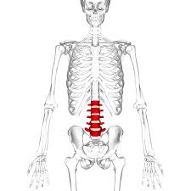
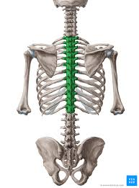
What are the names of the Vertebrae and how many bones are in each?
Cervical- 7
Thoracic- 12
Lumbar - 5

Slide 4
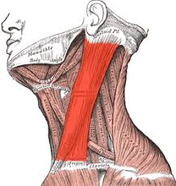
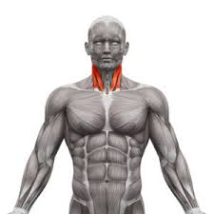
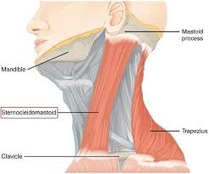
What muscle flexes and rotates the head?
Sternocleidomastoid

Slide 5
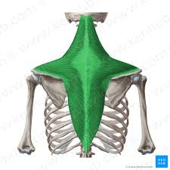
What movement does the Trapezius do?
Extends the neck, adducts the scapula's and shrugs the shoulders

Slide 6
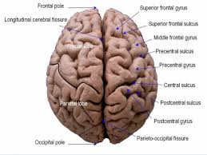
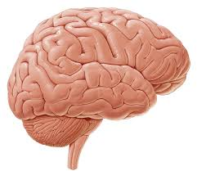
What is the large portion of the brain called that controls higher mental functions?
Cerebrum

Slide 7
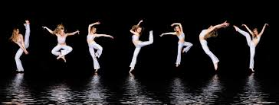
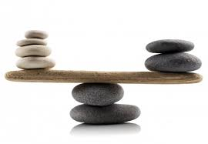
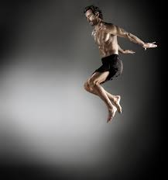
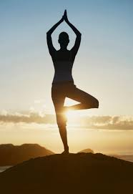
What does the Cerebellum control?
Balance and Movement

Slide 8
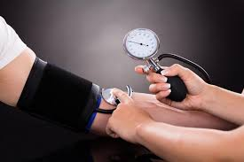
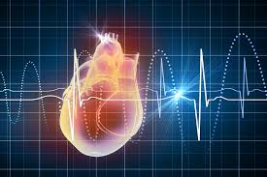
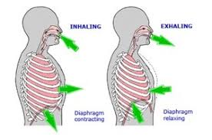
Why is the brainstem so important?
It controls all the vital functions such as heart rate, blood pressure and breathing

Slide 9
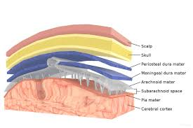
What is the covering around the CNS Called?
Meninges

Slide 10
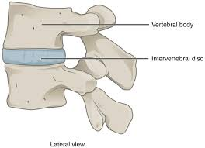
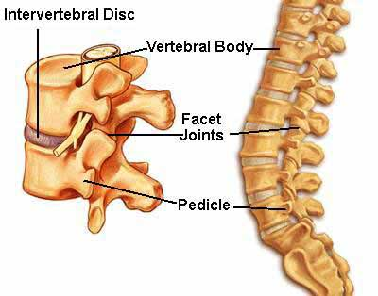
What are Cartilaginous disks that act as shock absorbers of the spine?
Intervertebral Discs

Slide 11
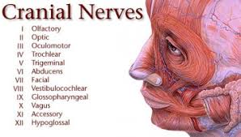
How many pairs of Cranial nerves do we have?
12 Pairs

Slide 12
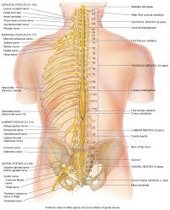
How many spinal Nerves pairs do we have?
31 Nerves

Slide 13
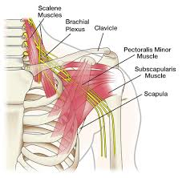
What is the Brachial Plexus? And what nerves are they?
A bundle of nerves
C5- T1

Slide 14
What are the 12 Cranial Nerves, and what do they each control?
Olfactory - Smell
Optic - Vision
Occulomotor – Eye Movement
Trochlear- Eye Movement
Trigeminal- Chewing face and mouth touch and pain
Abducens – Eye Movement
Facial- Facial expressions, tears and saliva and some taste
Auditory- Hearing, balance
Glossopharyngeal- Carotid blood pressure, some taste
Vagus – Aotic blood pressure, slows heart rate, Digestive organs, vitals
Spinal Accessory- Trapezius and sternocleidomastoid, swallowing
Hypoglossal- Controls tongue movements

Slide 15
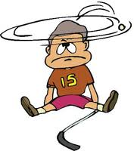
What is the injury due to a direct blow to the head resulting in bruising of the brain?
Cerebral concussion

Slide 16
What are some signs and symptoms of a concussion?
Headache
LOC
Tinnitus
Nausea
Irritability
Confusion
Disorientation
Dizziness
Amnesia
Photophobia
Sleep, vision and balance disturbances

Slide 17
Persistent symptoms following a concussion?
Post Concussive Symptoms

Slide 18
What is Second Impact Syndrome?
Rapid swelling of the brain from additional head trauma, life threatening

Slide 19
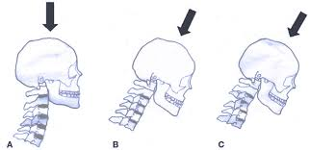
What is the mechanism of injury for a cervical spine fracture?
Axial Loading or forceful rotation of the neck

Slide 20
How do athletes get a stinger?
Shoulder depression with head forced to the opposite side

Slide 21
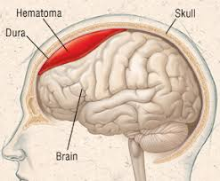
Where does a subdural Hematoma take place?
Below the dura mater and the brain

Slide 22
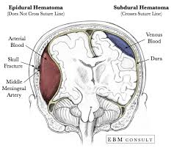
Where does an Epidural Hematoma take place?
Bleeding between the inside of the skull and the dura mater

Slide 23
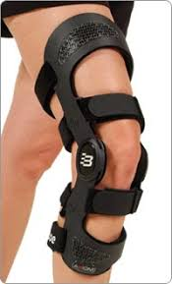
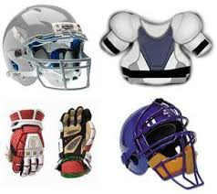
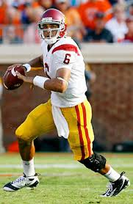
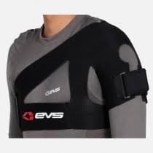
What is the purpose of protective equipment?
To prevent injury
Prevent re-injuiry

Slide 24
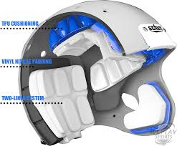
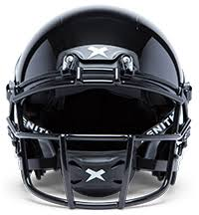
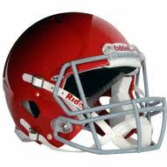
How does a helmet help to decrease head injuries?
Spreads high-velocity impacts over a large surface area through a firm exterior shell and decelerates the force that acts on the head through an energy absorbing liner

Slide 25
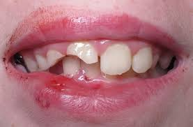
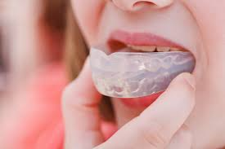
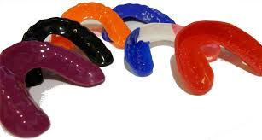
What are 2 reasons why athletes wear mouth guards?
Prevent dental trauma
Absorbs shock and decreases concussions

Slide 26
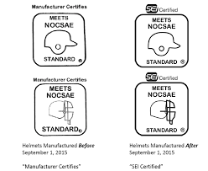
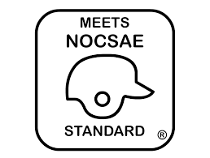
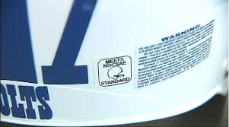
What does NOCSAE stand for?
National Operating Committee on Standards for Athletic Equipment

Slide 27
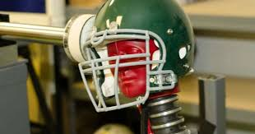
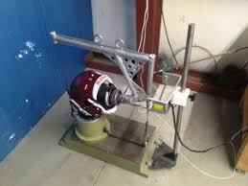
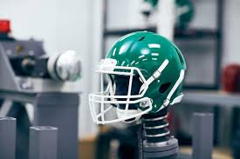
What does NOCSAE do?
Standardizes protective equipment
Tests equipment to make sure it is able to tolerate forces applies to many different areas
Must withstand repeated blows and high mass , low velocity impacts

