Slide 1
Reproductive And Fetal Development

Slide 2
Maintaining Reproductive Health
Males
Bathe Regularly
Wear Protective Equipment
Practice Abstinence
Perform Regular Self- Examinations
Get Regular Check Ups

Slide 3
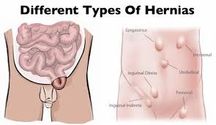
Male Reproductive System Problems
Inguinal Hernia- when part of the intestines push through a tear in the abdominal wall
Sterility- The inability to reproduce
Poor quality of sperm
Exposure to X-rays or radiation
Toxic chemicals and lead
Testicular cancer
14-40 years old
Prostate Cancer

Slide 4
Maintaining Reproductive Health
Female
Bathe Regularly
Have regular medical exams
Pap Smear
Mammogram
Perform regular self-examinations
Practice abstinence

Slide 5
Female Reproductive System Problems
Menstrual Cramps
Premenstrual Syndrome (PMS)
Hormonal changes
Anxiety, irritability,bloating, mood swings & fatigue
Toxic Shock Syndrome (TSS)

Slide 6
Infertility and Other Disorders
Endometriosis
Sexually Transmitted Diseases
Ovarian Cysts
Cervical, Uterine, and Ovarian Cancers

Slide 7
Fetal Development
Fertilization- the union of a male sperm cell and a female egg cell
Implantation- the process by which the zygote attaches to the uterine wall
Embryo- a cluster of cells that develops between the 3rd and 8th week of pregnancy
Fetus- Group of developing cells after 8 weeks

Slide 8
Amniotic sac- Thin fluid filled membrane that surrounds and protects the developing embryo
Umbilical cord- cord that connects the fetus with the mother’s placenta
Placenta- a thick, blood-rich tissue that lines the walls of the uterus during pregnancy and nourishes the embryo

Slide 11
What to eat while pregnant
Calcium
Protein
Iron
Vitamin A
Vitamin B complex
Folic Acid

Slide 12
Fitness- before starting an exercise program and expectant mother should discuss this with her doctor

Slide 13
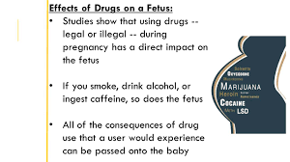
A Healthy Fetus
Expectant mothers should avoid tobacco, alcohol, drugs, and environmental hazards
Avoid Tobacco Use-
30 % of low birth weight
14% of premature births
10 % of all infant deaths
Affects growth, mental development and behavior

Slide 14
Avoid Alcohol Use-
Alcohol passes through umbilical cord
Fetus can not break down the alcohol quickly
Alcohol level stays high in the fetus
Fetal Alcohol Syndrome (FAS)- a group of alcohol-related birth defects that includes both physical and mental problems
Have learning, memory, attention problems, visual and hearing impairments

Slide 15
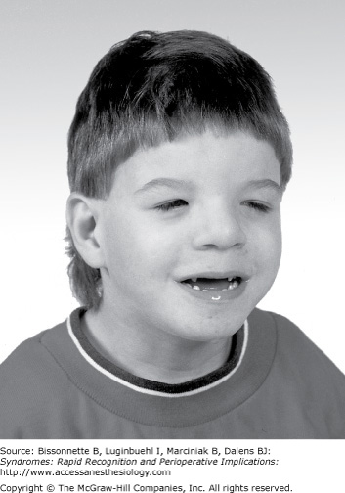
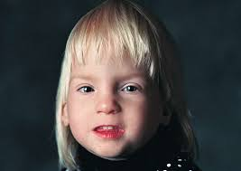

Slide 16
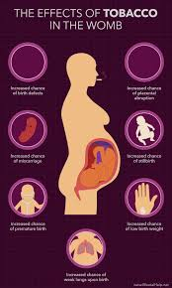
Drugs- only approved by doctor
Low birth weight
Respiratory or cardiovascular problems
Mental impairments
Birth defects
Baby may be born addicted to the drug

Slide 17
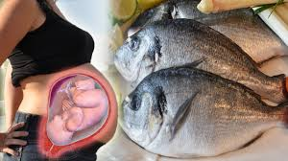
Avoid Hazards in the Environment
Lead- linked to miscarriage
Mercury- avoid certain fish
Smog or air pollution
Radiation- x rays

Slide 18
Childbirth
Step 1: Labor
Muscle contractions
Causes the cervix to dilate or widen
Step 2: Delivery
Baby passes through the birth canal
Baby takes it’s first breath and cries to clear its lungs of the amniotic fluid
Step 3: Afterbirth
Placenta is still attached to the umbilical cord
Contractions happen until the placenta is pushed out

