Slide 1
Reproductive Anatomy

Slide 2
Warning: If you can’t behave, then you will not Participate☺

Slide 3
Female Reproductive anatomy

Slide 4
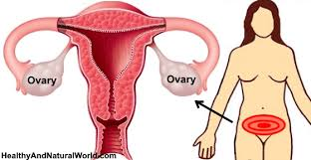
Ovaries
The female sex Glands that produce and store the ovum (eggs).
Women are born with all the eggs they will ever have
300,000 eggs
The ovaries also secrete and produce the female sex hormones

Slide 5
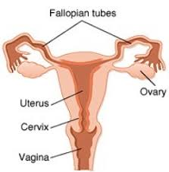
Fallopian Tubes
A tube that connects the ovaries to the uterus, where fertilization occurs
The are not connected to the ovaries, the finger like projections pick up the egg and the tube is lined with cilia to move the egg down to the uterus
Fertilization occurs usually in the first 1/3 of the tube
STD’s like gonorrhea and chlamydia destroy those cilia and is a cause of infertility

Slide 6
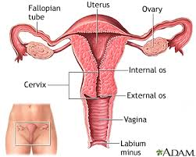
Uterus
The organ that prepares each month for a fertilized ovum (egg), it also supports the baby during pregnancy and contracts during birth
It is about the size and shape of a small pear. It is composed of muscular tissue and is hollow, like a thick balloon
The lining of the uterus is called the endometrium, this sheds if no fertilization takes place which is called the menstrual cycle
During pregnancy it stretches and grows to support the baby

Slide 7
Cervix
The lowest part of the uterus where mucus production aids in sperm transport and protects the fertilized ovum
This is what they measure during pregnancy just before labor when the mother has “dilated”
4 inches means the woman is going into labor
How many inches does the cervix need to dilate to for the baby to be able to come out?
10 inches

Slide 8
Vagina
The female sex organ that receives the penis, the passageway for the menstrual flow and the birth canal during birth
This is only a muscular passageway
This tube extends from the uterus to the outside of the body

Slide 9
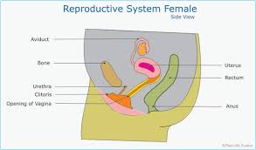
Clitoris
A small structure that is sensitive to sexual stimulation and is located above the opening to the vaginal
This structure is located externally

Slide 10
Male reproductive anatomy

Slide 11
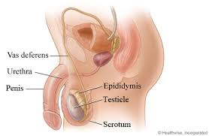
Testicles
The male sex gland that produces sperm and testosterone
The testes are made up of tiny seminiferous tubules
Tiny little tubes where the sperm is produced
Sperm is being produced every 8-10 days
There is 20-30 million sperm in 1 tablespoon
About 35 sperm reach the ovum
Ovum is 90,000 times larger than the sperm
Many sperm have two tails or two heads and die from the acidity of the female body

Slide 12
scrotum
A sac-like pouch that holds the testes and regulates their temperature
Sperm require a temperature considerably lower than what is found inside the body
The testicles and the scrotum hang from the body so the temperature is not as hot as the inside of the body

Slide 13
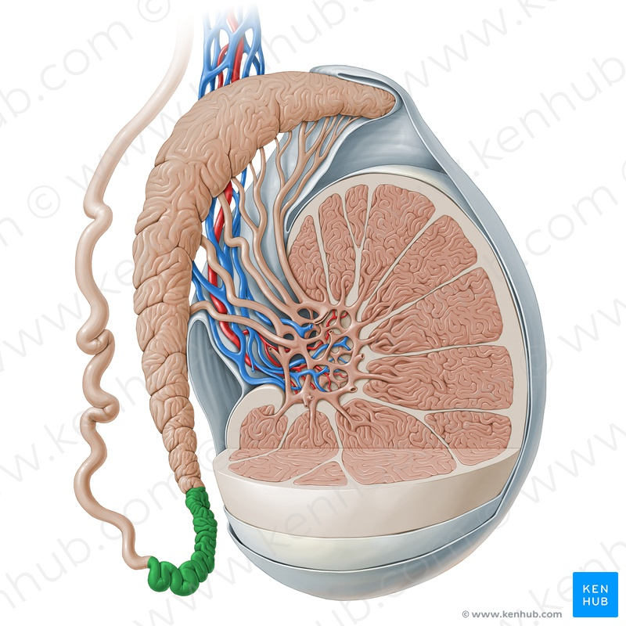
Epididymis
Tubules that lie on top of the testes where sperm mature
Tube winds about 20 feet long
It takes 2 months for sperm to mature

Slide 14
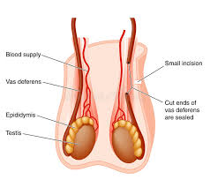
Vas Deferens
Tubes that transports sperm from epididymis to the urethra
This tube travels past the seminal vesicles and the prostate gland
This is the tube that is cut if a man gets surgery to become infertile

Slide 15
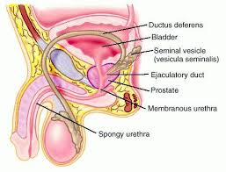
Seminal vesicles
Glands that produce a sugar fluid which gives the sperm energy
This fluid becomes part of the semen

Slide 16
Prostate Gland
This gland produces and alkaline fluid or a base fluid which will increase the sperms longevity in the woman’s body
This fluid comprises about 60% of the semen

Slide 17
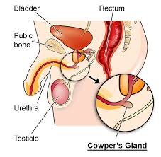
Cowper’s gland
A gland that produces a lubrication fluid which helps the sperm be mobile and be able to move around
This fluid becomes part of the semen and sits next to the penis

Slide 18
Urethra
The passageway for urine and semen
The tube that connects to the bladder and passes through the length of the penis

Slide 19
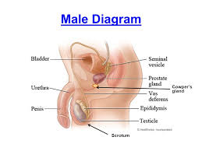
Penis
Male reproductive organ which deposits the sperm into the vaginal canal
This is attached to the trunk of the body
It is made of spongy erectile tissue
This tissue is filled with blood and the normally soft penis become stiff

Slide 20
ejaculation
The process where semen is discharged through the penis
100 to 600 million sperm may be deposited during sex

