Slide 1
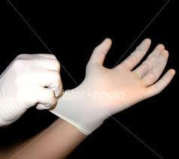
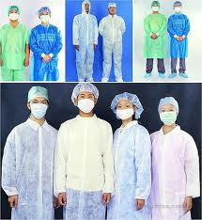
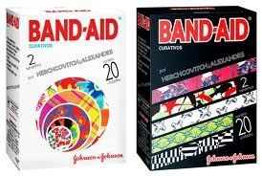
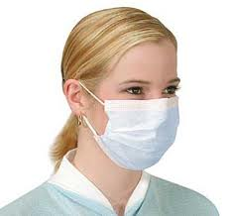
What is PPE
Personal Protective Equipment

Slide 2
What format do we use to perform a thorough assessment of injuries? It is divided into 4 basic steps
History
Inspection
Palpation
Special Tests

Slide 3
What is the most important step in HIPS
History

Slide 4
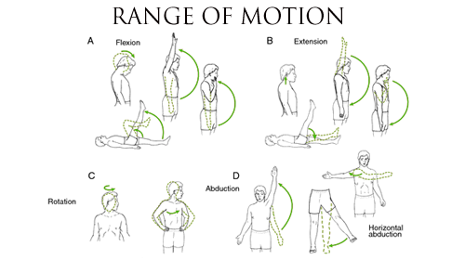
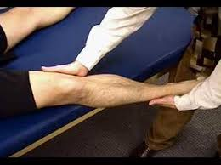
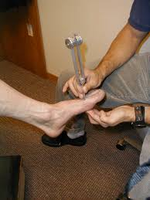
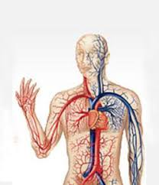
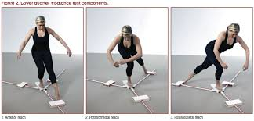
What are the 5 types of special tests?
ROM
Stress Tests
Neurological Exam
Circulatory Exam
Functional Tests

Slide 5
During the inspection phase, what are 3 things you should look for?
Swelling
Discoloration
Deformity
Bleeding
Posture
Limping
Holding the body area
Facial Expressions

Slide 6
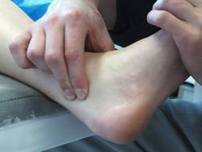
What does Palpation mean?
To examine by touch

Slide 7
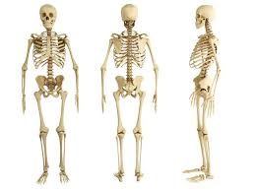
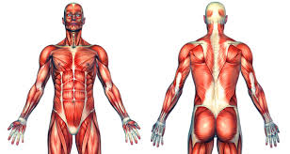
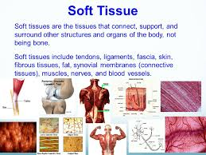
What areas should be palpated
Bones
Muscles
Soft Tissues

Slide 8
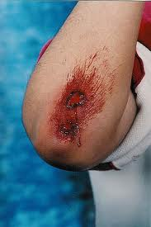
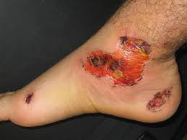
What is this injury?
Abrasion

Slide 9
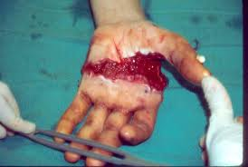
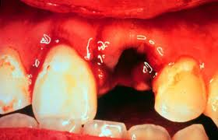
What is this injury?
Avulsion

Slide 10
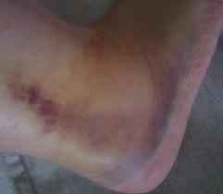
What is this injury?
Contusion

Slide 11
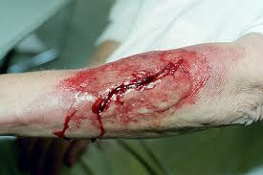
What is this injury?
Laceration

Slide 12
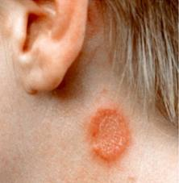
What is this injury?
Tinea Corporis
Ringworm

Slide 13
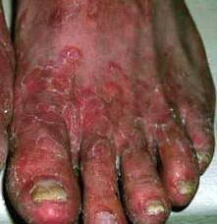
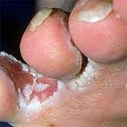
What is this injury?
Tinea Pedis
Athletes Foot

Slide 14
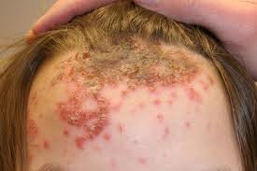
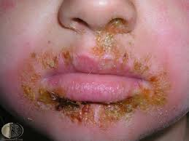
What is this injury?
Highly contagious
Impetigo

Slide 15
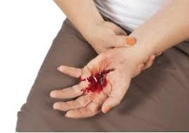
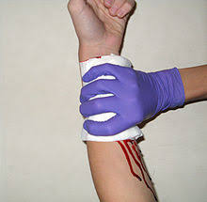
What is bleeding or hemorrhaging where there is loss of blood from the arteries and veins that is visibly seen?
External Bleeding

Slide 16
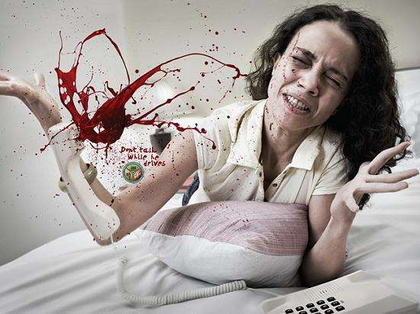
What type of bleeding is hard to control and needs immediate attention and might spurt?
Arterial

Slide 17
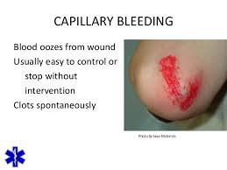
What type of bleeding has a great chance of infection?
Capillary

Slide 18
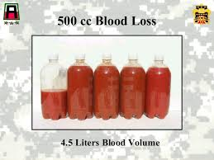
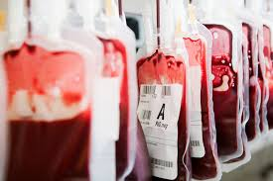
How many liters of blood do we have circulating through our bodies?
6 liters

Slide 19
What percent lost of blood is considered critical?
10 %

Slide 20
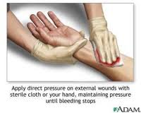
What type of pressure should be applied to a bleeding wound?
Direct

Slide 21
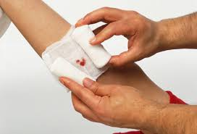
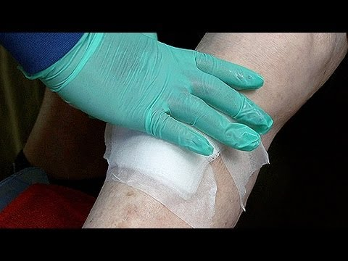
If you apply a sterile dressing on the bleeding area, and it gets full of blood, what should you do?
Add new dressings on top of the old ones.

Slide 22
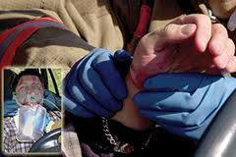
After a pressure bandage has been applied to hold the dressing in place, where should you check circulation?
Distal to the injury

Slide 23
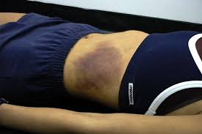
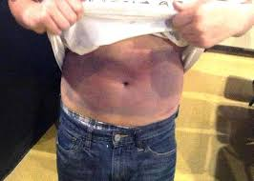
What type of bleeding is not visually seen?
Internal

Slide 24
What are a few signs and symptoms of internal bleeding?
Swollen or rigid abdomen
Bruises on chest or fractured ribs
Blood in vomit
Abnormal pulse and difficulty breathing
Cool moist skin

Slide 25
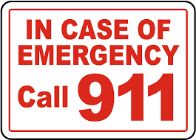
If internal bleeding is suspected what should be done immediately?
Activate EMS

Slide 26
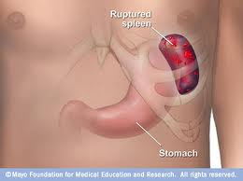
This injury results from a fall or direct blow to the upper left quadrant?
Ruptured Spleen

Slide 27
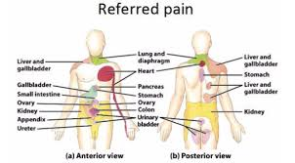
What is Kehr’s Sign?
A referred pain occurring to the left shoulder an because of a ruptured spleen

Slide 28
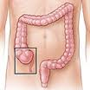
What has localized right lower quadrant pain with nausea and vomiting?
Appendicitis

Slide 29
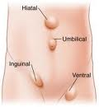
What is a Hernia?
Protrusion of the intestines through a portion of the abdominal wall

Slide 30
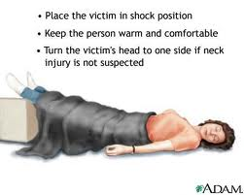
Treatment is to call EMS, Elevate legs 12 inches, Do not give anything to eat or drink and monitor vitals
What is shock

Slide 31
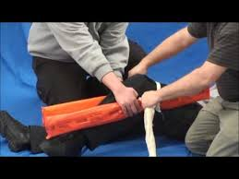
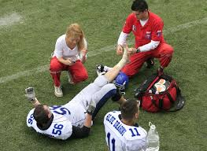
If a body part needs to be immobilized, what is the best way to complete it accurately?
When in doubt……. SPLINT
1. Splint only if you can do it without causing more pain and discomfort
2. splint in the position you find it in
3. Apply the splint so that it immobilizes the bone as well as the joints above and below
4. check the circulation distal to the injury
5. Do not move the athlete before they
have been splinted

Slide 32
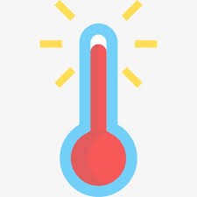
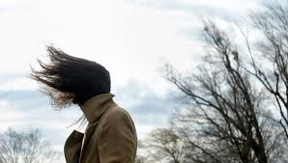
Maintaining body temperature is affected by what 3 factors?
Air Temperature
Humidity
Wind

Slide 33
What are the three Heat illnesses? And list them from least severe to most?
Heat Cramps
Heat Exhaustion
Heat Stroke

Slide 34
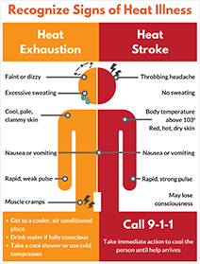
What are signs and symptoms of Heat exhaustion vs Heat Stroke?
Heat Exhaustion
Heat Stroke
Profuse sweating
Wet, cool and clammy skin
Headache
Weakness
Dizziness
Fatigue
Nausea
ALC
Hot, DRY skin
Red and flushed
Headache
Dizziness
Weakness
Convulsions
unconsciousness

Slide 35
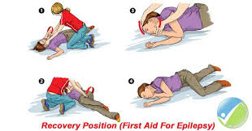
How do we Treat Seizures
Protect them from any objects around them
Do not hold them down
Do not put anything in their mouth
Monitor their airway

Slide 36
How do we Treat Diabetes
If they are conscious administer sugar, candy, fruit juice or soda
Call 911 if it doesn’t get better after 5 minutes

Slide 37
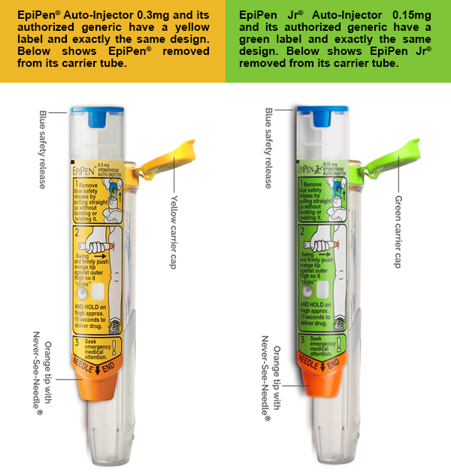
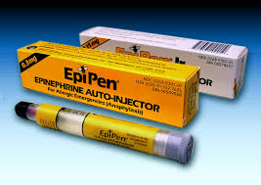
How do we treat Anaphylactic shock
Use an EPI Pen
Call 911

Slide 38
How do we treat sudden cardiac arrest
Cardiac Chain of survival
Early recognition
Early CPR
Early AED
Early Advanced medical care

