Slide 1
The Health Risks of Tobacco Use

Slide 2
Nicotine
Nicotine- the addictive drug found in tobacco leaves
All tobacco products
Addictive Drug- a substance that causes physiological or psychological dependence
Stimulant- a drug that increases the action of the central nervous system, heart, and other organs

Slide 3
Poisonous Substances in Tobacco Smoke
Carcinogen- a cancer-causing substance
same compounds found in paint, rat poison and toilet cleaner
Tar- a thick, sticky, dark fluid produced when tobacco burns
Paralyzes and destroys cilia
Destroys alveoli
Susceptible to bronchitis, pneumonia, emphysema, heart disease and cancer

Slide 4
87% of cancer deaths result from smoking
Carbon Monoxide- colorless, odorless and poisonous gas
Deprives body's tissues and cells of oxygen
Increases HBP, heart disease, hard arteries

Slide 5
Pipes, Cigars and smokeless Tobacco
Cigars contain significantly more nicotine and produce more tar and carbon monoxide than cigarettes
1 cigar’s nicotine content = 20 cigarettes
Smokeless tobacco- tobacco that is sniffed through the nose, held in the mouth, or chewed

Slide 6
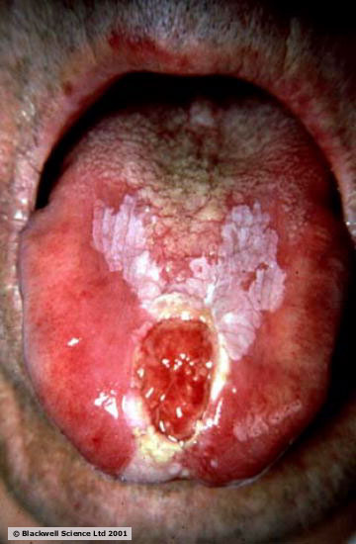
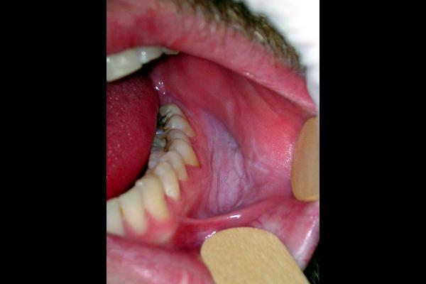
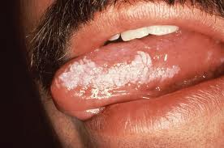
Leukoplakia- thickened, white, leathery- looking spots on the inside of the mouth that can develop into oral cancer

Slide 7
Short-Term Effects
Brain chemistry changes
Respiration and heart rate increase
Taste buds are dulled and appetite is reduced
Users have bad breath, yellowed teeth, and smelly hair, skin and clothes

Slide 8
Long-Term Effects
Chronic Bronchitis
Emphysema
Lung Cancer
Coronary Heart Disease and Stroke
A Weakened Immune System

Slide 9
Other Consequences
Costs to Society
Cost 167 billion dollars each year
Cost to Individuals
Legal Consequences

Slide 10
Benefits of Living Tobacco-Free
Better Cardiovascular endurance
Improve fitness levels and athletic performance
Reduce risk of lung cancer, heart disease and stroke

Slide 11
Strategies for Avoiding Tobacco
Surround yourself with positive influences
Reduce peer pressure
Be prepared with refusal skills

Slide 12
Ending the Addiction Cycle
Nicotine Withdrawal- process that occurs in the body when nicotine, an addictive drug, is no longer used
Irritability
Difficulty concentrating
Anxiety
Sleep disturbances
Cravings

Slide 13
Nicotine Substitutes- products that deliver small amounts of nicotine into the user’s system while he or she is trying to give up tobacco
Gum
Patches
Nasal sprays
Inhalers

Slide 14
Getting Help to Quit Tobacco Use
Prepare for the quit day
Get support and encouragement
Access professional health services
Tobacco cessation program- a course that provides information and help to people who want to stop using tobacco
Replace tobacco use with healthy behaviors

Slide 15
Health Risks of Tobacco Smoke
Environmental Tobacco Smoke (ETS)- second hand smoke, is air that has been contaminated by tobacco smoke
Mainstream smoke- the smoke exhaled from the lungs of a smoker
Sidestream smoke- the smoke from the burning end of a cigarette, pipe, or cigar

Slide 16
Health risks from non smokers
Secondhand smoke causes about 3000 deaths from lung cancer each year
Eye irritation
Headaches
Ear infections
Coughing
Asthma worsens

Slide 17
Health Risks of Children of Smoker
High rates of sore throats, ear infections and upper respiratory problems
Slow lung development, weak lungs

Slide 18
Reducing your risks
Encourage a family member to quit
Create smoke free areas/ outside
Open windows
Set up meeting places where there can’t be smoking

