Slide 1
Identify the bones of the lower extremity
Femur
Patella
Tibial Tuberosity
Fibula
Tibia
Tarsals
Metatarsals
Phalanges

Slide 2
Identify the bones of the lower extremity
Talus
Metatarsals
Calcaneus
Phalanges

Slide 3
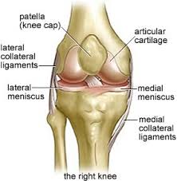
Two Joints of the knee?
Tibialfemoral
Patellofemoral

Slide 4
Joints of the ankle
Tibiotalar
Midfoot
Sub Talar or Calcaneotalar
MP Joint
PIP
DIP

Slide 5
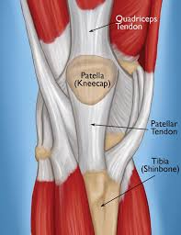
What structure attaches the quadriceps to the tibial tuberosity?
Patellar tendon

Slide 6
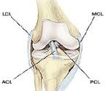
What do each of these ligaments mean?
Medial Collateral Ligament
Lateral Collateral Ligament
Anterior Cruciate Ligament
Posterior Cruciate Ligament
MCL
LCL
ACL
PCL

Slide 7
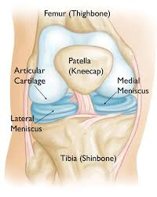
What is the purpose of the meniscus?
To cushion and deepen the joint

Slide 8
Ankle ligaments Lateral
Anterior Tibiofibular ligament
Anterior Talofibular Ligament

Slide 9
WHERE IS THE Deltoid Ligament located?
Medial Side of the Ankle

Slide 10
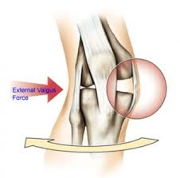
What ligaments resists valgus forces?
MCL

Slide 11
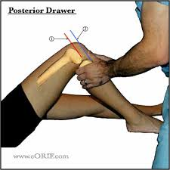
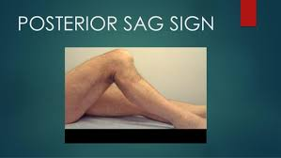
What ligament resists posterior displacement of the tibia
PCL

Slide 12
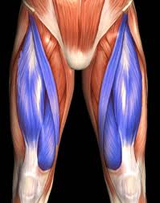
What muscle group extends the knee? And what are each of them? What movement does this muscle group do?
Quadriceps
Rectus Femoris
Vastus Medialis
Vastus Lateralis
Vastus Intermedius
Extends the Knee

Slide 13
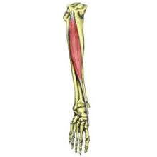
What movement does the tibialis anterior
Dorsiflexion

Slide 14
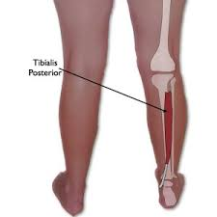
Which muscle is the shin splint muscle and performs inversion?
Tibialis Posterior

Slide 15
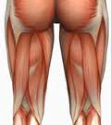
What is the largest muscle that flexes the knee? What motion does the hamstring do?
Biceps Femoris
Knee Flextion

Slide 16
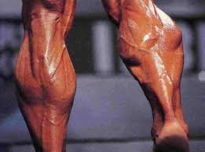
What ankle movement does the Gastrocnemius do?
Plantar flexion

Slide 17
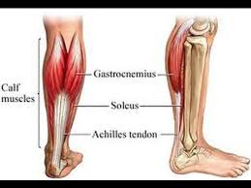
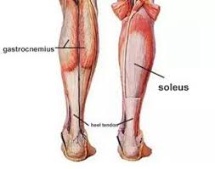
Which muscle lies deep to the gastrocnemius?
Soleus

Slide 18
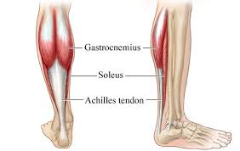
What is the attachment call that attaches the gastroc and the soleus to the calcaneus?
Achilles Tendon

Slide 19
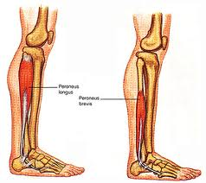
What muscles EVERT the foot and ankle?
The Peroneal muscles

Slide 20
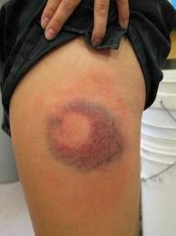
What is this injury?
Thigh Contusion

Slide 21
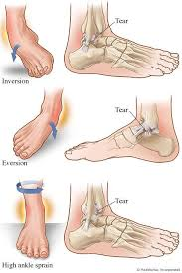
What are the three different ankle sprains? And how do they each happen?
1. Inversion Sprain
Roll the ankle inward
2. Eversion Sprain
Ankle rolls outward
Syndesmosis Sprain
Forced inversion with rotation of the talus

Slide 22
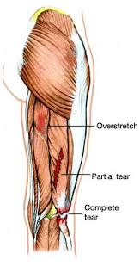
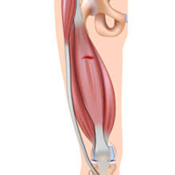
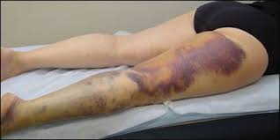
How does a quadriceps or hamstring injury take place?
A sudden stretch or sudden contraction

Slide 23
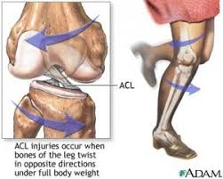
What type of injury is caused because of weight bearing and a rotational force?
Meniscus Tear

Slide 24
What type of injury of the knee occurs because of Varus Force
LCL sprain

Slide 25
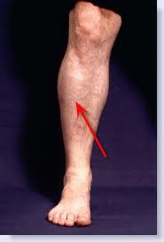
Diffuse pain in distal medial tibia, that increases with activity
Medial tibial stresss syndrome
Shin Splints

Slide 26
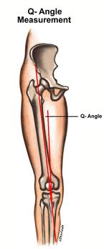
What is Patellofemoral syndrome?
Abnormal tracking of patella in the femoral groove due to:
Tight hamstring and calf muscles
Increased Q angle
Weak quadriceps

Slide 27
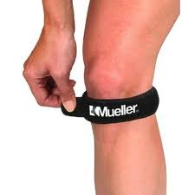
Vague pain and tenderness of the patellar tendon and worsens with jumping activities
Patellar tendinitis
Jumpers knee

Slide 28
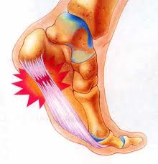
What is Plantar fasciitis?
Medial heel pain, usually in the morning
Caused by tight calf muscles
Poor arch support
Leg length discrepancy

Slide 29
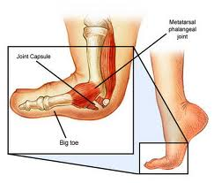
Hyperextension sprain of the great toe
Turf Toe

Slide 30
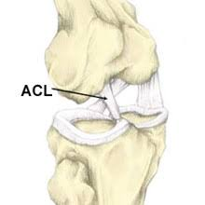
What motion Does the ACL prevent?
Anterior movement or displacement of the tibia

Slide 31
Identify each of these structures
What knee is this
5.
4.
1.
3.
2.

Slide 32
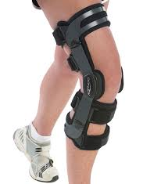
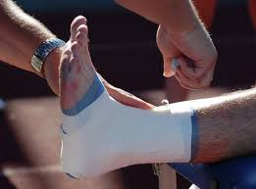
What does the word Prophylactic mean?
To prevent

Slide 33
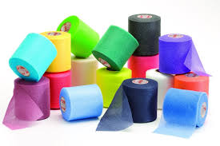
Why would you put pre-wrap on the skin before taping?
To protect the skin.
But it decreases the effectiveness

Slide 34
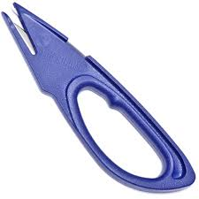
What are these called? And what do they do?
Sharks
Cut of a Tape Job

Slide 35
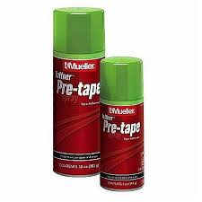
What is the purpose of adhesive spray?
It is tape adherent to ensure bonding of the tape to the skin

Slide 36
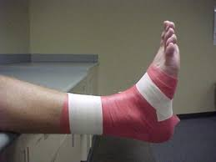
What is an anchor in a tape job?
Provides a firm base for other tape ends to attach to

Slide 37
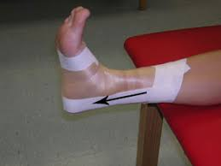
What is a stirrup and what direction does it go?
A vertical U piece of tape to support the sides of the ankle.
It goes Medical to Lateral

Slide 38
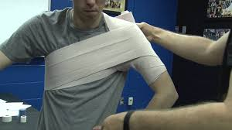
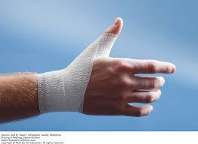
What is a Spica? And what joints would you do this wrap at?
A figure 8 wrap around a joint
Thumb, Big Toe, Hip and Shoulder

Slide 39
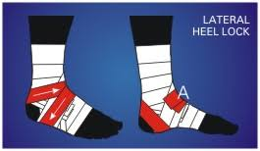
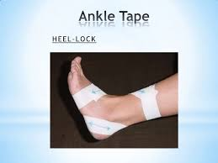
What does a Heel Lock taping technique prevent?
Inversion and Eversion

Slide 40
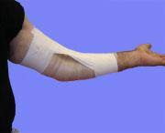
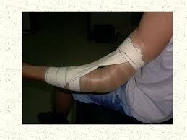
What motion does a Checkrein prevent?
Hyperextension

Slide 41
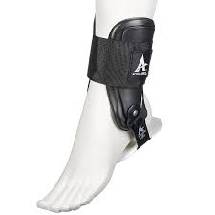
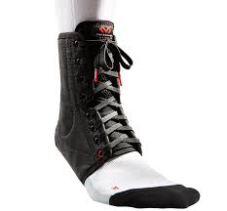
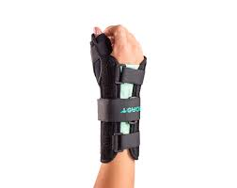
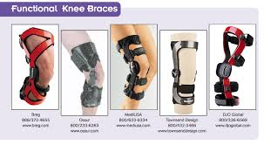
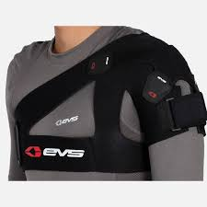
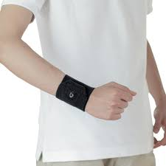
Describe the difference between prophylactic bracing and functional bracing
Prophylactic is to prevent and injury or avoid and injury
Functional braces are to prevent re-injury

