Slide 1
Sexually Transmitted Diseases

Slide 2
What are STDs?
Sexually Transmitted Diseases- Infections spread from person to person through sexual contact.
AKA- STI
Direct genital contact or the exchange of bodily fluids
Bacterial infections; cured with medication
Viruses; are incurable
Asymptomatic- individuals show no symptoms or the symptoms are mild and disappear after the onset of the infection
This is very dangerous, a person may not know they are infected and will pass it on to another

Slide 3
The risk of contracting an STD increases as the number of sexual partners increases.
9 million people 15-24 will become infected with an STD each year
Females are more likely to suffer complications from STS and the effects are more serious in females than in males

Slide 4
STD | Estimated number of new cases each year | Reported cases (2007)
Human Papillomavirus (HPV) | 6.2 Million | 5.5 Million
Chlamydia | 3 Million | 1,108,374
Genital Herpes | 1 Million | 317,000
Gonorrhea | 700,000 | 355,991
Trichomoniasis | 7.4 Million | 205,00
Syphilis | 70,000 | 40,920
Hepatitis B | 120,000 | 46,000

Slide 5
Common STDs
Genital HPV Infections (Human Papillomavirus)
Caused by HPV
More than 100 kinds of viruses
Can cause genital warts
Asymptomatic
Some HPV infections if not treated may cause abnormal pap test or may result in cervical cancer

Slide 6
Chlamydia
Bacterial infection that affects reproductive organs
3 X more likely in females
Asymptomatic
Most common among teens
If untreated can become pelvic inflammatory disease and infertility
Pregnant females may deliver prematurely, and babies might be born with eye infections or pneumonia

Slide 7
Genital Herpes
Caused by the herpes simplex virus
Simplex 1 = Mouth
Simplex 2 = genital
Asymptomatic till blisters appear
Blisters break causing sores
Antiviral treatments can help lessen the frequency but there is no cure

Slide 8
Gonorrhea
Bacterial STD that affects mucous membranes
2nd most reported
If untreated it can cause severe health problems such as infertility.
Bacteria can also spread to the blood stream and cause permanent damage to the body’d joints
Women can pass it to their babies

Slide 9
Trichomoniasis
Microscopic protozoan that results in infections of the vagina, urethra, and bladder
Temporary irritation inside the penis, mild discharge, or slight burning after urination
Females often experience vaginitis that has discharge, odor, irritation and itching

Slide 10
Syphilis
Caused by a small bacterium called a spirochete
Develop sores in the genital area lasting for weeks
Has three stages
Primary a sore appears and can easily be treated
Second stage infection causes a skin rash
Third syphilis can damage internal organs, cause brain dementia and may cause death

Slide 11
The STD epidemic
Out of the 19 million people who are infected, ½ are under the age of 24
STDs go undiagnosed and untreated because of:
Embarrassment or fear
Lack of Symptoms
Misinformation
Notification policies

Slide 12
Preventing and Treating STDs
The most Successful method to prevent the spread of STDS is………………….. ABSTINENCE!!!!!!!!!!
Antibiotics- a class of chemical agents that destroy disease-causing microorganisms while leaving the patient unharmed

Slide 13
To help you protect your health and stay committed to abstinence follow these:
Set personal limits on physical affection
Avoid dating someone who is sexually active or who pressures you
Avoid situations where you feel pressured
Avoid people who make fun of your decisions
Choose group outings where you can enjoy the company
Be clear about your decisions, and discuss it with others
Practice your refusal skills

Slide 14
Avoid High- Risk Behaviors and STDs
Avoid:
Being sexually active with more than 1 person
Engaging in unprotected sex
Engaging in sexual activity with high risk partners
Using alcohol and other drugs

Slide 15
HPV Vaccine
HPV vaccine- a vaccine that can prevent cervical cancer, pre-cancerous genital lesions (or sores), and genital warts caused by genital HPV infection.

Slide 16
Diagnosing and treating STDS
If STDs are not diagnosed and treated early, serious long term consequences can result
Anyone who thinks they might be infected should go talk with a health care professional. Many clinics provide information and treatment for free

Slide 17
Act Responsibly
Practice Abstinence
Report any known infections
It is the responsibility of any person infected with an STD to notify everyone with whom he or she has had sexual contact

Slide 18
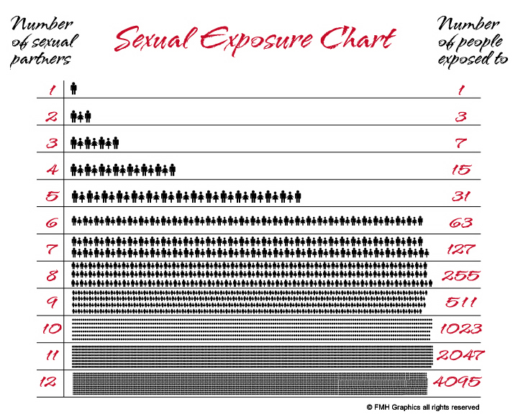
When you have sex with someone, you are having sex with everyone they have had sex with for the last ten years, and everyone they and their partners have had sex with for the last ten years."

