Slide 1
Positive Self-Talk

Slide 2
The health benefits of positive thinking
Increased life span
Lower rates of depression
Lower levels of distress
Greater resistance to the common cold
Better psychological and physical well-being
Reduced risk of death from cardiovascular disease
Better coping skills during hardships and times of stress

Slide 3
Identifying negative thinking
Filtering. You magnify the negative aspects of a situation and filter out all of the positive ones. For example, say you had a great day at work. You completed your tasks ahead of time and were complimented for doing a speedy and thorough job. But you forgot one minor step. That evening, you focus only on your oversight and forget about the compliments you received.
Personalizing. When something bad occurs, you automatically blame yourself. For example, you hear that an evening out with friends is canceled, and you assume that the change in plans is because no one wanted to be around you.
Catastrophizing. You automatically anticipate the worst. The drive-through coffee shop gets your order wrong and you automatically think that the rest of your day will be a disaster.
Polarizing. You see things only as either good or bad, black or white. There is no middle ground. You feel that you have to be perfect or that you're a total failure.

Slide 4
Focusing on positive thinking
Identify areas to change. If you want to become more optimistic and engage in more positive thinking, first identify areas of your life that you typically think negatively about, whether it's work, your daily commute or a relationship, for example. You can start small by focusing on one area to approach in a more positive way.
Check yourself. Periodically during the day, stop and evaluate what you're thinking. If you find that your thoughts are mainly negative, try to find a way to put a positive spin on them.
Be open to humor. Give yourself permission to smile or laugh, especially during difficult times. Seek humor in everyday happenings. When you can laugh at life, you feel less stressed.

Slide 5
Focusing on positive thinking, cont.
Follow a healthy lifestyle. Exercise at least three times a week to positively affect mood and reduce stress. Follow a healthy diet to fuel your mind and body. And learn to manage stress.
Surround yourself with positive people. Make sure those in your life are positive, supportive people you can depend on to give helpful advice and feedback. Negative people may increase your stress level and make you doubt your ability to manage stress in healthy ways.
Practice positive self-talk. Start by following one simple rule: Don't say anything to yourself that you wouldn't say to anyone else. Be gentle and encouraging with yourself. If a negative thought enters your mind, evaluate it rationally and respond with affirmations of what is good about you.

Slide 6
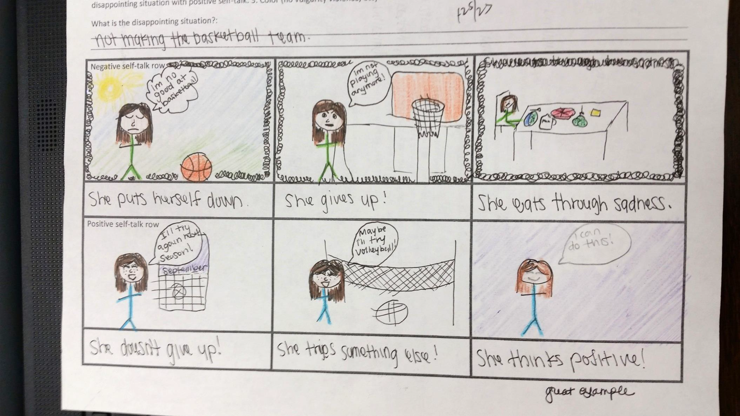

Slide 7
Quick Review
Mental and Emotional Health
The ability to accept yourself and others, express and manage emotions, and deal with the demands and challenges you meet in life.
Values
The ideas, beliefs and attitudes about what is important that help to guide the way you live
Decision Making
1.State the situation 2. List the Options 3.Weigh the possible outcomes 4.Consider values 5. Make a decisions and Act on it 6. Evaluate the decision
Self Esteem
How much you value, respect and feel confident in yourself
Positive and negative self talk (Comic Strip)
Emotions

