Slide 1
Developing Your Self-Esteem
Chap 3 Lesson 1

Slide 2
Define Mental/Emotional Health
The ability to accept your-self and others, express and manage emotions, and deal with the demands and challenges you meet in life.

Slide 3
What are the characteristics of good mental and emotional health?
1. Sense of belonging
2. Sense of purpose
3. Positive outlook
4. Self-sufficiency (having confidence to make responsible decisions that promote your sense of independence and self-assurance)
5. Healthy self-esteem

Slide 4
Terms and Definitions
Define Resilient: the ability to adapt effectively and recover from disappointment, difficulty, or crisis
Define Self-Esteem: how much you value, respect, and feel confident about yourself
Define Competence: having skills enough to do something
Define Self-Talk: the encouragement or criticism that you give yourself. Can be positive or negative.
Notes:
Can anyone think of someone they know who has been through a tough time but has been able to recover from it?
What are some examples of positive self talk?
What are some examples of negative self talk?

Slide 5
How can you improve your self-esteem?
Choose friends who value and respect you
Focus on the positive aspects about yourself
Replace negative self talk with supportive self-talk
Work towards accomplishments rather than perfection
Consider your mistakes learning opportunities

Slide 6
How can you improve your self-esteem?
Try new activities to discover your talents
Write down your goals and the steps you will take to achieve them
Exercise regularly to feel more energized
Volunteer your time to help someone
Accept the things you can’t change, and focus your energy on changing the things you can.
Notes:
Has anyone tried a new activity and discovered a talent?
Anyone doing volunteer?

Slide 7
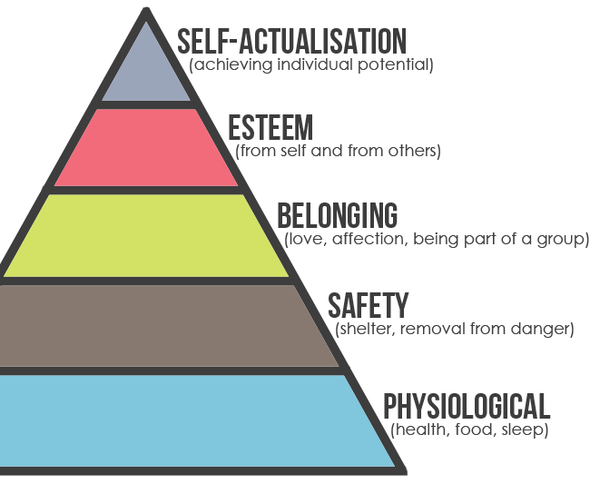
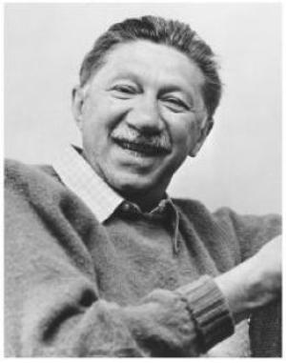

Slide 8
Maslow’s Hierarchy of Needs
Level 1: Physical-need to satisfy basic needs of hunger, thirst, sleep and shelter
Level 2: Safety- need to be secure from danger
Level 3: Belonging- need to be loved and need to belong
Level 4: Feeling Recognized- need to achieve, need to be recognized
Level 5: Reaching Potential- need for self-actualization

Slide 9
Self-Actualization
to strive to be the best you can

Slide 10
Soul Surfer
One way to improve self-esteem is to focus on the positive aspects of yourself. What positive aspects about herself did Bethany focus on?
Another way to improve self-esteem is to work towards accomplishments rather than perfection. Think of examples in the movie that showed Bethany focusing on accomplishments rather than perfection.
Where did Bethany do some volunteer work? In what ways this experience change her life?
Notes:
Phuket Thailand December 26 2004
Death toll: approx 230,000 people

Slide 11
Bethany Hamilton
Dad created a handle to go on surfboards to help with duck-diving
WON the United States national under-18 surf championships! (2005 NSSA National Championships, Explorer Women’s division) age 15
3rd at the Roxy Pro in Australia – her best yet finish in a professional surfing competition! age 18
5th place at US Open of Surfing in California!
2nd place at the World Junior (under 20) Championships in Sydney, Australia and 3rd place at the Rio Surf International (WQS) in Rio de Janiero, Brazil! age 19
Volunteer work, Many appearances, interviews, awards, etc
Married at age 23
She and her husband placed 2nd on the “Amazing Race”
Baby boy June 2015

Slide 12
Positive Self-Talk

Slide 13
The health benefits of positive thinking
Increased life span
Lower rates of depression
Lower levels of distress
Greater resistance to the common cold
Better psychological and physical well-being
Reduced risk of death from cardiovascular disease
Better coping skills during hardships and times of stress

Slide 14
Identifying negative thinking
Filtering. You magnify the negative aspects of a situation and filter out all of the positive ones. For example, say you had a great day at work. You completed your tasks ahead of time and were complimented for doing a speedy and thorough job. But you forgot one minor step. That evening, you focus only on your oversight and forget about the compliments you received.
Personalizing. When something bad occurs, you automatically blame yourself. For example, you hear that an evening out with friends is canceled, and you assume that the change in plans is because no one wanted to be around you.
Catastrophizing. You automatically anticipate the worst. The drive-through coffee shop gets your order wrong and you automatically think that the rest of your day will be a disaster.
Polarizing. You see things only as either good or bad, black or white. There is no middle ground. You feel that you have to be perfect or that you're a total failure.

Slide 15
Focusing on positive thinking
Identify areas to change. If you want to become more optimistic and engage in more positive thinking, first identify areas of your life that you typically think negatively about, whether it's work, your daily commute or a relationship, for example. You can start small by focusing on one area to approach in a more positive way.
Check yourself. Periodically during the day, stop and evaluate what you're thinking. If you find that your thoughts are mainly negative, try to find a way to put a positive spin on them.
Be open to humor. Give yourself permission to smile or laugh, especially during difficult times. Seek humor in everyday happenings. When you can laugh at life, you feel less stressed.

Slide 16
Focusing on positive thinking, cont.
Follow a healthy lifestyle. Exercise at least three times a week to positively affect mood and reduce stress. Follow a healthy diet to fuel your mind and body. And learn to manage stress.
Surround yourself with positive people. Make sure those in your life are positive, supportive people you can depend on to give helpful advice and feedback. Negative people may increase your stress level and make you doubt your ability to manage stress in healthy ways.
Practice positive self-talk. Start by following one simple rule: Don't say anything to yourself that you wouldn't say to anyone else. Be gentle and encouraging with yourself. If a negative thought enters your mind, evaluate it rationally and respond with affirmations of what is good about you.

