Slide 1
What Is Health??

Slide 2
Health
Is the combination of your physical, mental/emotional, and social wellbeing.

Slide 3
Physical Health
Is the way the parts and systems of you body work together.
-Need to have proper nutrition
-Regular physical activity
-Enough rest and sleep
-Good hygiene
-Regular medical and dental checkups
-Resist putting harmful substances in our bodies

Slide 4
Mental and Emotional Health
Includes your feelings about yourself, how well you relate to others, and how well you meet the demands of daily life.
-Use mind to develop thinking skills
-Loves learning
-Mistakes are opportunities to learn, grow, and change
-Stands up for their beliefs and values
-Avoid dwelling on negative thoughts

Slide 5
Social Health
Is the quality of your relationships with friends, family and anyone you come in contact with each day.
-Ability to make and keep friends
-Work and play in cooperative ways
-Good communication
-Show respect and care for yourself and others

Slide 6
Health Triangle

Slide 7
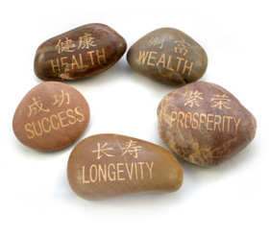
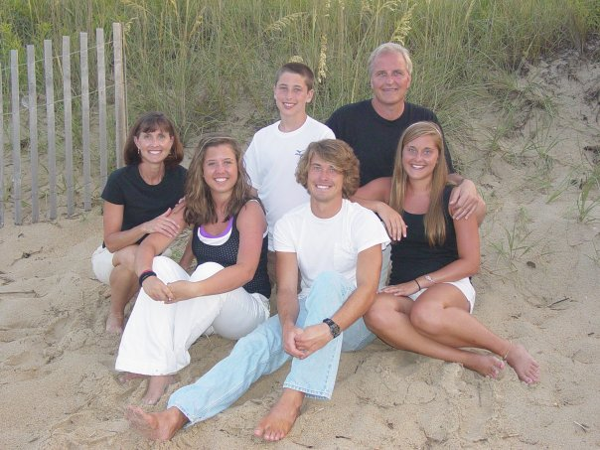
Wellness
An overall state of well-being, or total health.

Slide 8
-Wellness is based on making good healthy decisions and practicing those behaviors
- It is also an ongoing, lifelong commitment to physical, mental/emotional, and social health.

Slide 9
3 Ways of Taking Charge of Your Own Wellness
Knowledge- an important way to improve your health is through your knowledge.
Lifestyle- One of the most important ways to improve your health is to make behavioral changes in your lifestyle. Putting your knowledge into action is a sure way to take charge of your wellness
Attitude- A person’s way of thinking, or attitude, greatly affects that person’s health.

Slide 10
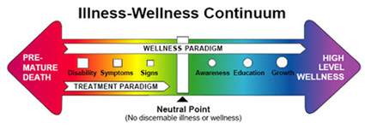
Health Continuum
Health is Dynamic. We are always being bombarded with life’s pressures that can affect our health
Our health fluctuates along a continuum
From day to day, and year to year, we experience different levels of health

Slide 11
Life Style factors
Personal behaviors and habits related to the way a person lives, that help determine his or her level of health

Slide 12
Life Style Factors
Get between 7-8 hours of sleep a night
Eat nutritious foods from the various food groups each day
Refrain from smoking and using tobacco products
Eat breakfast daily
Do 20-30 minutes of nonstop vigorous activity a minimum of 3 times per week
Do not use alcohol or other drugs
Maintain your recommended weight
Notes:
How many of these do you guys do on a regular basis?

Slide 13
How long do you think you will live???
-8 years for smoking 2 packs a day
-10 years for 3+ oz of alcohol per day
-5 years if you eat more than 2500 calories per day
-5 years if you eat excess fat
-8 years if you eat excess sugars
-10 years for not exercising 3 X per week
-10 years if you are obese
-7 years for having excess stress
-5 years for having depression

Slide 14
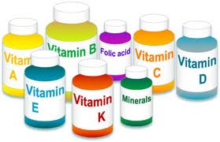
Prevention
Practicing healthy habits to keep a person well and free from disease and other ailments

Slide 15
Health Education
Is the providing of accurate health information in such a way as to influence people to change their attitudes so that they take a positive action about their health

Slide 16
Health literacy
Describes and individual's capacity to obtain, interpret, and understand basic health information and services and use such information and services in ways that promote his or her health and wellness

Slide 17
Critical thinker and problem solver- able to evaluate information before making a decision
Responsible, productive citizen- acts in a way that promotes the health of the community, nation and the world. Will choose safe, healthful and legal behaviors and will show respect
Self-directed learner- is able to gather accurate, current health information throughout life
Effective communicator- the ability to express one’s knowledge, beliefs and ideas in a variety of forms

