Slide 1
Brain Development

Slide 2
Teen Brain Quiz
Number in your notebooks 1-5 and answer these questions. True or False
Your brain is completely developed by age 8.
You can make choices that will affect your brain development.
Alcohol abuse may have long-term effects on the make up of the brain.
The Frontal Cortex is located directly behind your forehead.
The Frontal Cortex is responsible for coordination of muscles and physical movement.

Slide 4
Teen Brain Development
During the teen years, the brain does not grow in size, but it changes. Between age 16- and 20…
the brain develops so that the adolescents are more able to control what they do
This brain development allows adolescents to gain better control over their emotions
The brain develops so that adolescents become better at planning and understanding abstract concepts

Slide 5
Adolescents can make choices that will affect their brain development….
When a teenager concentrates on math, music, sports, or other activities that require thinking, new circuits can form in the brain.
When a teenager chooses passive, non-thinking activities and just “hangs out” or watchers a lot of TV, the brain will make circuits for that kind of activity.

Slide 6
Kids who “exercise” their brains by learning to order their thoughts, understand abstract concepts, and control their impulses are laying the neural foundations that will serve them for the rest of their lives.

Slide 7
This argues for doing a lot of things as a teenager. You are hard-wiring your brain in adolescence. Do you want to hard-wire it for sports and playing music and doing mathematics, or for lying on the couch in front of the television?????

Slide 8
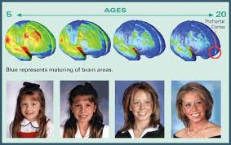
So, adolescents’ decisions about how to make their brains “work” will affect the way their brain develops. To carry out the work of the brain, during adolescence and throughout life, on needs a good supply of oxygen (from exercise) and protein (from food). By improving cardiovascular health, one can increase the flow of oxygen-rich blood to the brain. This has been shown to improve brain function.

Slide 9
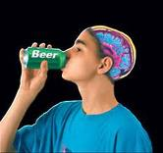
Affect of Alcohol on Teen Brain
Research on humans has show the first concrete evidence that heavy, on-going alcohol use by adolescents can impair brain functioning. Research on 15 and 16 year olds showed cognitive impairments in teen alcohol abusers, compared with non-abusing peers, even weeks after they stop drinking. This suggests that abuse of alcohol by teens may have long-term negative effects on the make up of their brains

Slide 10
Values
Values-beliefs, ideas and attitudes about what is important that help guide the way you live
Being unsure about your values can complicate your decision making ability.
Being clear about your values strengthens your ability to make decisions that fit into your value system

